Slide 1
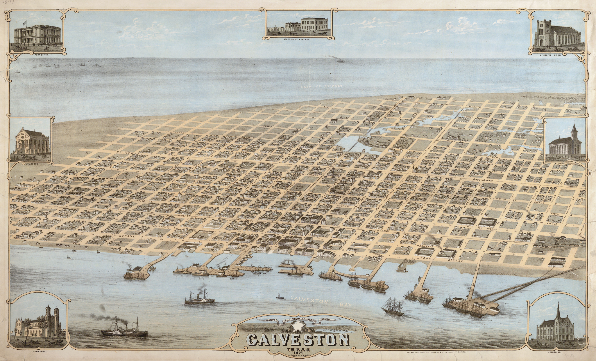
Surge Protection for the
City of Galveston
Advancing the Ike Dike Concept

Slide 2
Report on $250K Galveston IDC monies
$250K spent specifically on surge modeling at Homeland Security Center of Excellence at Jackson State and A&M student salaries
Presentation today also includes results from other funding
A&M Matching Funds of at least $700K
Other Funding direct to A&M of about $700K
Bay Area Coastal Protection Alliance (BACPA) and other funding to A&M’s research partners
Monies obtained by and expended at the SSPEED Center
No State or Federal Monies

Slide 3
Why Academic-led Surge Research
Lead Role in the Galveston Bay Region - Unique in US
Texas A&M Galveston and Rice Have Put Together Very Strong Teams
Initially TAMUG hoped to work with 6-County District but Delays in Funding and Their Restrictive Public Information Policies Have Made that Impossible
USACE Started Work in Galveston Bay ($4.4) but Redirected Work to Sabine and Brazoria; Trying to Begin Again with Texas Coast Project
But Even if They Do, the Traditional USACE Process Has Never Led to Large Surge Protection Projects
Instead Special Federal Legislation Has Caused Their Implementation

Slide 4
Special Legislation Since 2005
USACE Funding Appropriated (million $)
P.L. 109-62 (FY2005 Hurricane Katrina | $400
P.L. 109-148 (FY2006 Hurricanes Katrina, Rita, Wilma, Ophelia | $2,361
P.L. 109-234 (FY2006) Hurricanes Katrina, Rita | $3,653
P.L. 110-28 (FY2007) Hurricanes Katrina, Rita | $1,433
P.L. 110-252 (FY2008-09) Hurricane Katrina (+ recent storms) At least | $5,762
P. L. 110-329 (FY2008) Hurricane Katrina (+ recent storms) At least | $1,500
P. L. 111-32 (FY2009) Hurricane Katrina (+ recent storms) At least | $439
P.L. 113-2 (FY2013) Hurricane Sandy | $5,081
Total $20,629B

Slide 5
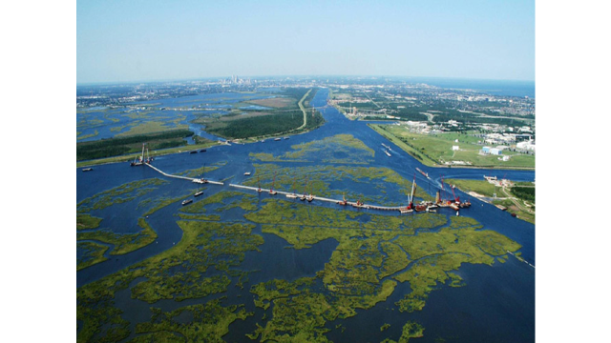
NOLA’s Surge Barrier is In Place

Slide 6

Our Region’s Bottom Line
Other Hard-hit Areas Have Received Billions to Build Protection and to Plan Additional Protection
Ike Hit Us Hard and a Major Hurricane Hits the Upper Texas Coast about every 14 years - Its Been Almost 7 Years Since Ike – 10 since Rita
But There Have Been No Federal Expenditures in Galveston Bay to Protect the Petrochemical Capital of the US Despite its Strategic National Importance
The US Is Playing Russian Roulette with Galveston Bay
Aided by Those Trying to Delay Any Progress
We Should Feel a Sense of Urgency and of Outrage

Slide 7
Probable Timing of Next Special Legislation
Can Hope for Proactive Legislation for Houston/Galveston
But Most Likely Will Be Reactive - Event Driven
Storm Event - Significant New Damage Anywhere in US
Large Request Requiring Special Legislation Event - Next Round of Sandy-Related Legislation, which May Be Soon - USACE has Completed $50M (No Match) Studies – Implementation Will Be Many Billions
Sandy Area Will Have a Plan – New Orleans Had a Very Rough Plan
We Will Need a Plan To Compete for Funds

Slide 8
Our Research Goal
Provide a Sound Basis for Special Legislation for the Galveston Bay Region As Soon As Possible
An Actionable Plan for Comprehensive Surge Protection of the Galveston Bay Region
And, with our implementation partners, Public Information in Support of this Plan and to help guide Special Congressional Legislation

Slide 9
Our Strategy
Provide the Very First Cut at an Actionable Plan this Hurricane Season
Improve it and Re-release an Improved Version Every Year Until the Region Gets Congressional Legislation
Our Major Role Stops with Congressional Legislation
We want Congress to Instruct the USACE to Complete the Final Design, Build and Maintain the Protective Structure Elements of the Plan
The USACE, as They Did in New Orleans, Can Quickly Build an Effective Barrier Here; But It Will Require Special Legislation

Slide 10
Who we are
Integrated Academic-led Research Team Investigating Multiple lines of Surge Defense – Including the Coastal Barrier
Researchers Devise an Actionable Plan and Provide Content to Implementation and Outreach Organizations
Wide Range of Public Support from Communities, Organizations, Businesses and Individuals

Slide 11
TAMUG/SPEED Research Team
Economics
  Drs Bill Gilmer and Adam Perdue, Institute for Regional Forecasting, University of Houston
  Dr Hanadi Rifai, University of Houston
  Drs Sam Brody, Wes Highfield and Meri Davlasheridze, TAMUG
Surge Modeling
  Drs Robert Whalin, Tom Richardson and Bruce Ebersole; Homeland Security Center of Excellence, Jackson State University
  Dr Jeff Melby, USACE/Engineering Research & Development Center
  Dr Clint Dawson, The University of Texas
Barrier Design
  Dr Bas Jonkman, Delft Technical University
  Dr Jens Figlus, TAMUG
  Dr Phil Bedient, Larry Dunbar, Rice University
  Drs Galen Newman and Eric Bardenhagen, Landscape Architecture, TAMU
Overall Flood Risk Reduction/Project Coordination/Public Outreach/Data and Information Accessibility
  Dr Sam Brody, COL Len Waterworth and Dr Bill Merrell, TAMUG
  Dr Phil Bedient, Larry Dunbar, Jim Blackburn, Rice University

Slide 12
Academic-led Research but Much More than Academics
Strong Implementation Partners and Supporters
Bay Area Houston Economic Partnership (BAHEP) and other economic partnerships – 12 endorsements
BAHEP – International Maritime Advisory Committee
BACPA – 501c3 – Supports Research and Public Outreach
Formal Endorsements from 22 Cities and Harris County Mayors and Councils Association
Formal Endorsement from the East Harris County Manufacturers Association (130+ Manufacturing Companies)

Slide 13
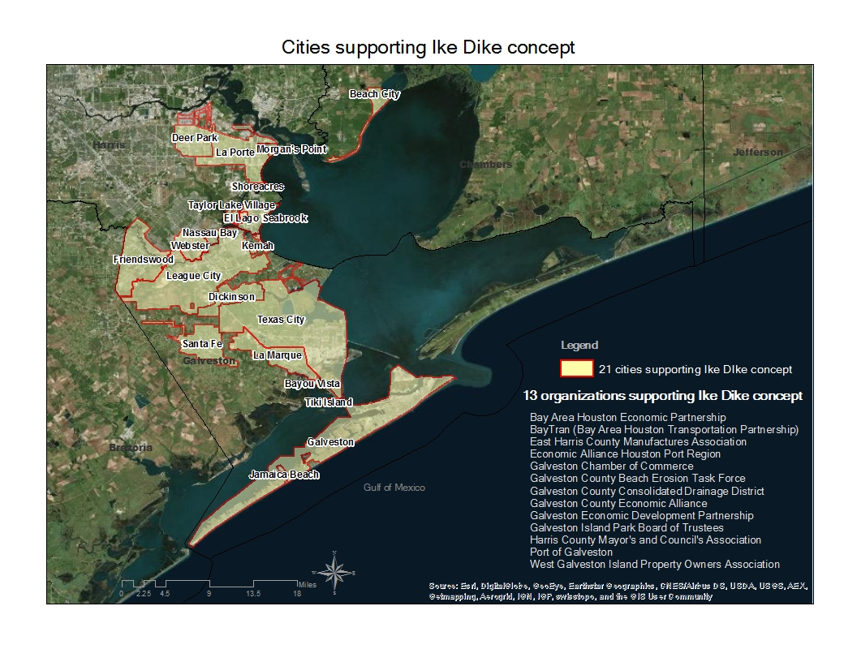
Cities and organizations supporting the Ike Dike Concept

Slide 14
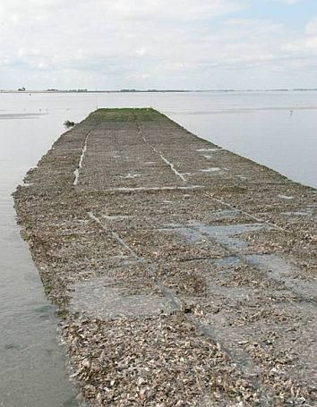
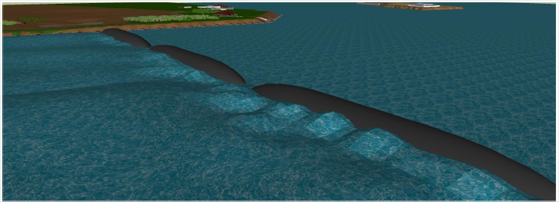
Overall Galveston Bay Solution
Multiple Lines of Protection
Stop as Much Surge as Practicable Near the Coast
Coastal Barrier Risk Reduction (TAMUG-led)
Risk Reduction Measures Within the Bay (SSPEED-led)
Oyster reefs
Inflatable barriers

Slide 15
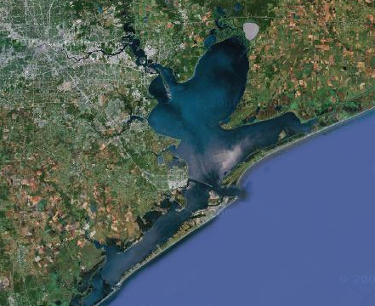
The A&M-led strategy is to keep the ocean surge out of Galveston Bay using a gated coastal barrier
Houston Ship Channel
High
Island
Bolivar Peninsula
Bolivar Roads
Galveston Island
Existing Seawall
Intracoastal Waterway
Coastal Spine
• San Luis Pass
Notes:
The critical need is to stop the surge at the coast – this protects the entire Bay area
1. Protects from catastrophic overflows and
2. Doesn’t allow the ocean surge into the Bay which in turn prevents massive internal surges

Slide 16
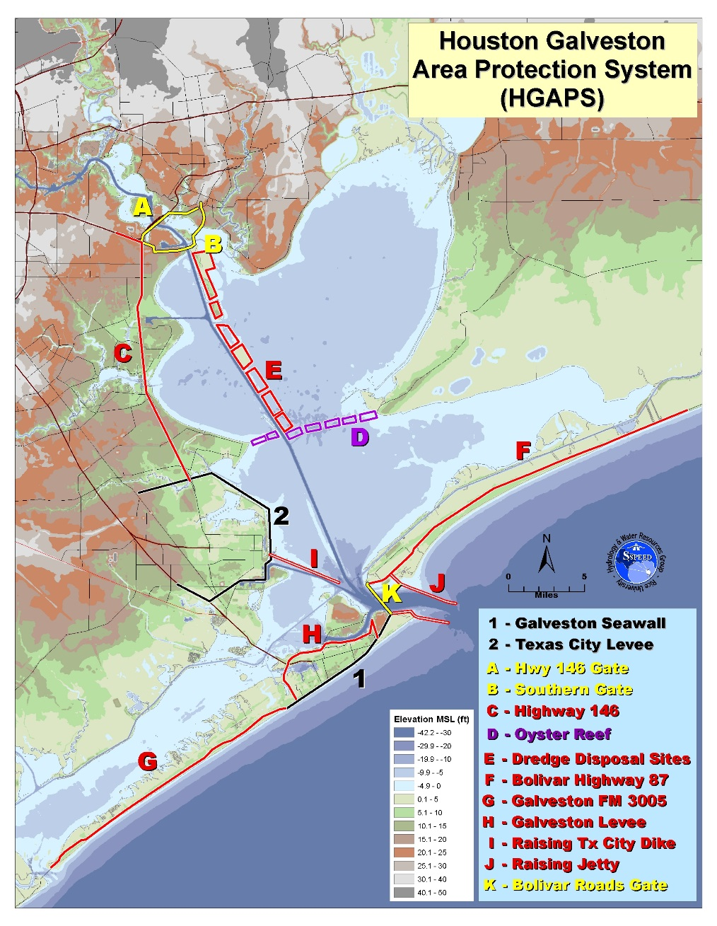
HGAPS Alternatives

Slide 17
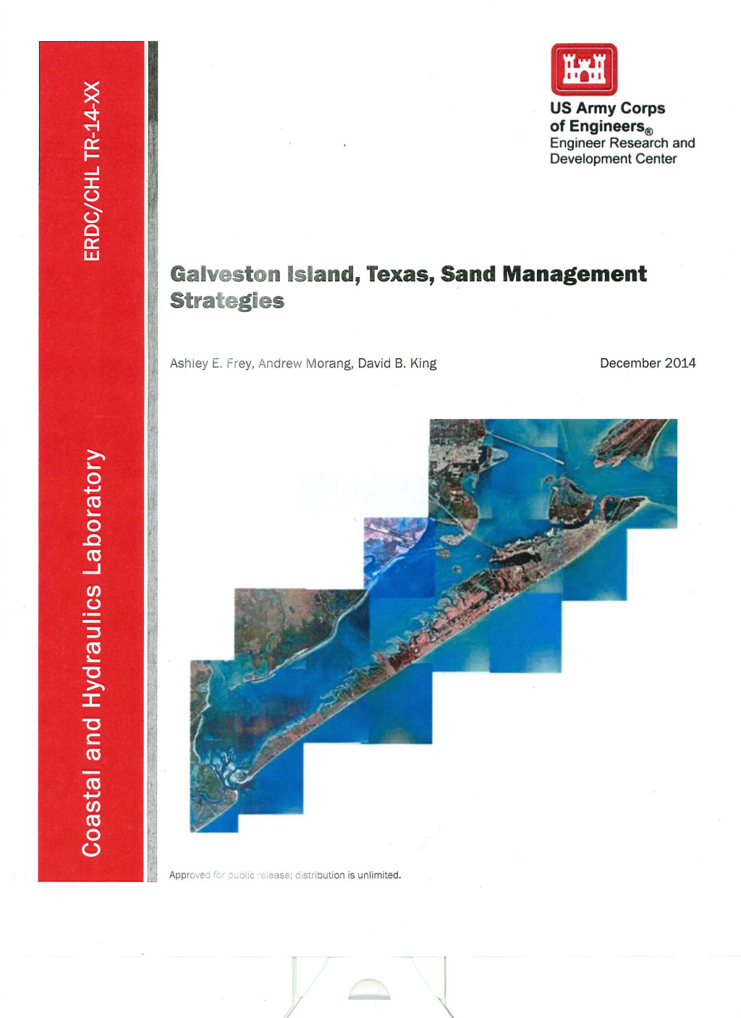
Beach-the first line of defense

Slide 18
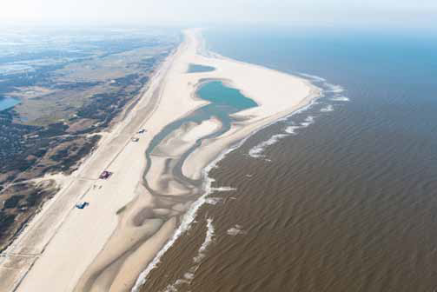
The Sand Motor Concept

Slide 19
Where We Are Towards a Very First Cut at an Actionable Plan
TAMUG Concentrating on Surge Reduction from the Coastal Barrier
Very First Cut Will Focus on Economics, in particular, a Preliminary but Credible Cost/Benefit Analysis of the Coastal Barrier
Cost/Benefit Is the Most Critical Aspect of Receiving Federal Funding
Expanding this Very First Cut into a More Rigorous Plan Will Require More than Local Funds

Slide 20
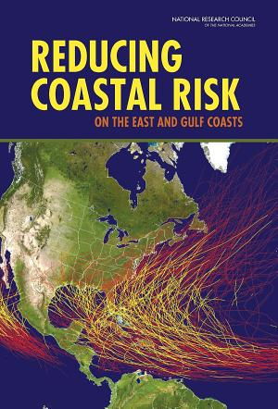
National Research Council Report
Hard Structures Are Likely to Become Increasingly Important
No Solid Basis for 100 Year Level of Protection
Benefit-Cost Analysis Provides a Reasonable Framework for Evaluating Coastal Risk Management Investments
  Constrained by Acceptable Risk and Social and Environmental Dimensions

Slide 21
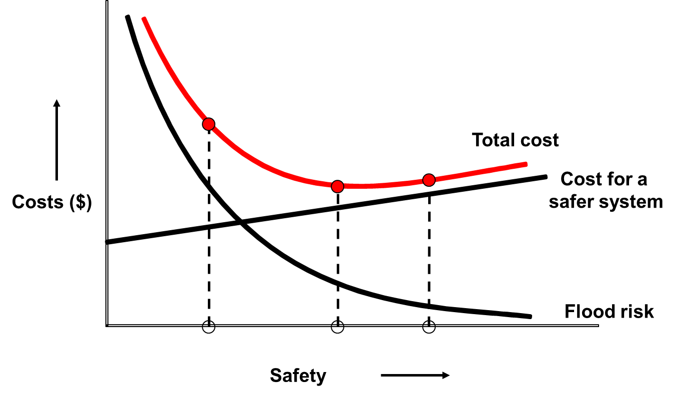
Flood Risk and Optimization
Flood Risk=probability (per year) × consequences
Consequences: economic, life loss, environmental etc.
Various risk criteria: individual, societal risk, economic
Risk reduction benefits
Optimize level of protection
Economic optimization

Slide 22
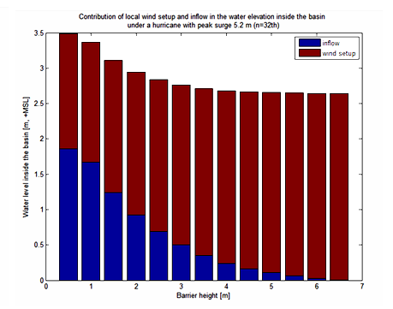
Optimizing barrier height
What is the optimal height of the storm surge barrier in terms of cost efficiency and damage prevention inside the basin?

Slide 23
Determining Benefits
Preliminary HAZUS Damage Estimate Work Completed for 4 Storms
Need to Run More Storms – Determine Probabilities of Inundation in Region
Need to Add Petrochemical detail – UH Gilmer on Plant Value - SSPEED on Individual Plant Vulnerability and Storage Tank Vulnerability
Need to Add Business Disruption and Take Those Effects Nationally
Add Many Other Benefits – Environmental, Social, Flood Insurance
Some are Difficult to Monetize

Slide 24
Preliminary Incomplete Surge Level and Economic Damage Analysis
ADCIRC and HAZUS Models

Slide 25
Storm Surge Modeling
Defined a “Bracketing Set” of 25 Storms
  High-intensity hurricanes on various tracks
  Varying-intensity hurricanes on a single direct-hit track
Performed storm simulations for both existing and with-Ike Dike conditions
  Compared results to quantify storm surge suppression benefits
  Provided input to initial economic analysis
Developed improved understanding of Houston-Galveston regional storm surge response to hurricanes (open coast and in-bay)
  With and without the dike
  As a function of hurricane intensity and track

Slide 26
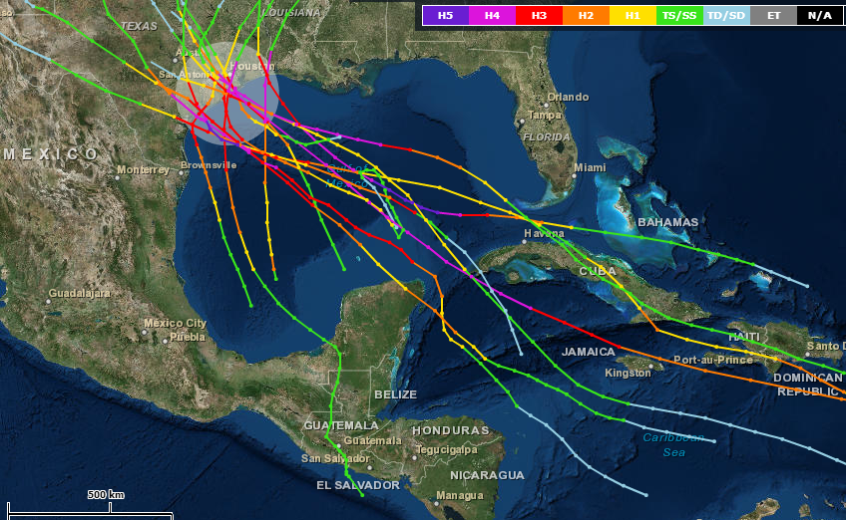
Historic category
3, 4, 5 hurricanes
(from NOAA )

Slide 27
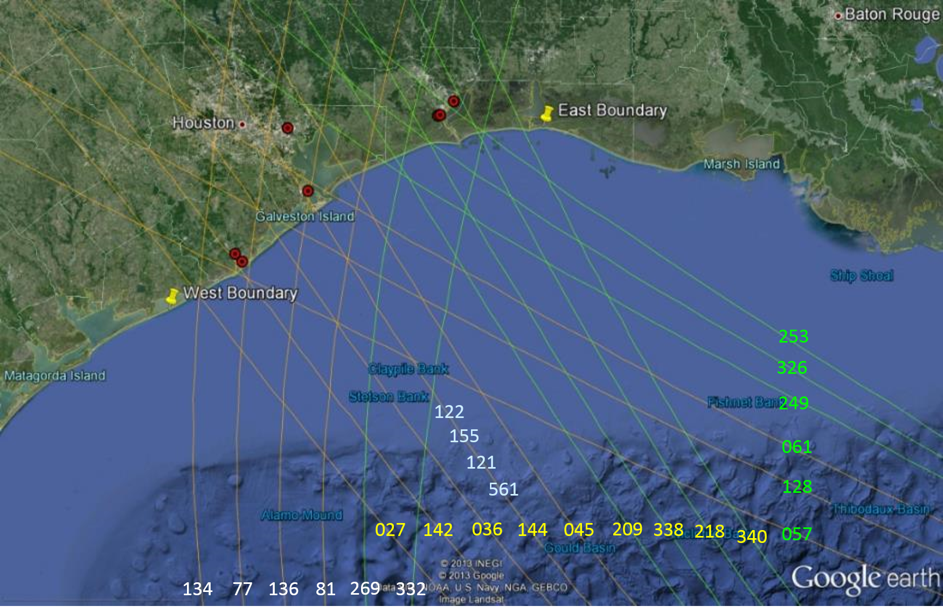



Hurricane Track Groupings and Storm Numbering
  21 hurricanes on different tracks (all 900 mb)
  4 hurricanes of varying intensity on a “direct hit” track (900, 930, 960 and 975 mb)

Slide 28
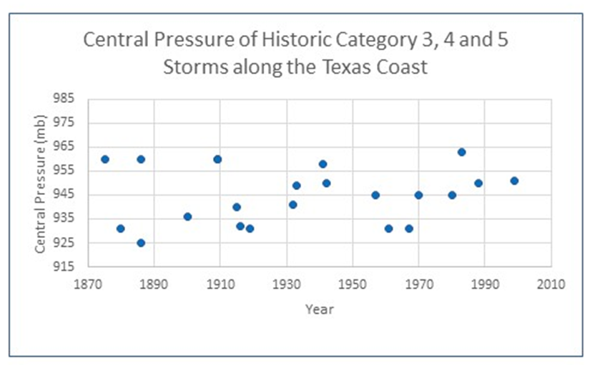
Modeling Surge and Residual Bay Surge
How high can the surge get in various parts of the Galveston Bay system?
900-, 930-, and 960-mb storms on direct hit path to examine surge distribution with and without a 17ft above sea level coastal barrier
960-mb weak cat 3
930 cat 4 (1900 Storm about 936-mb)
900-mb very rare but possible - 900 off chart
960 mb
930 mb
900 mb ------------------------------------

Slide 29
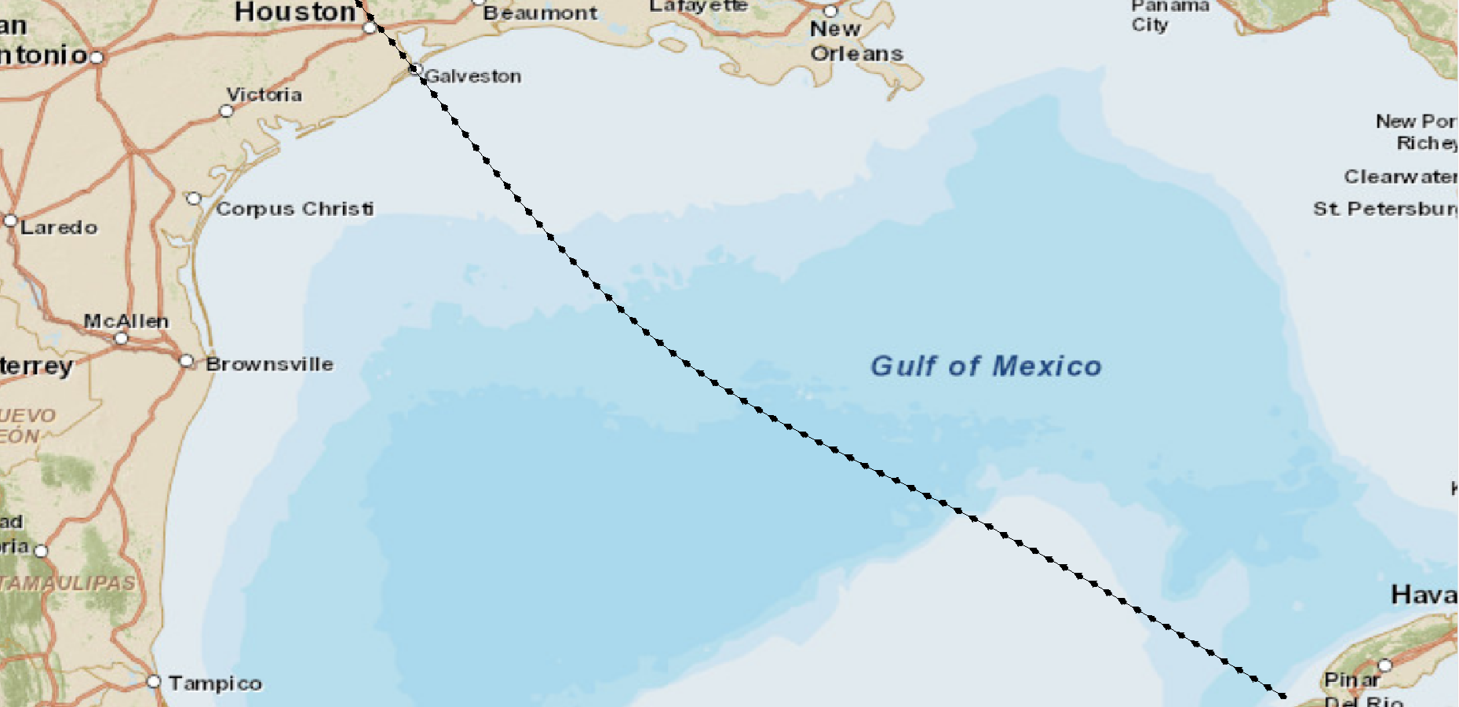
Path of Storms
(Storm 122)
CP=900 mb
Rmax= 17.7 nm
Vf= 11 knots

Slide 30
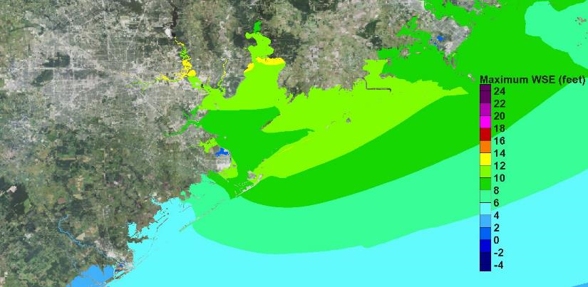
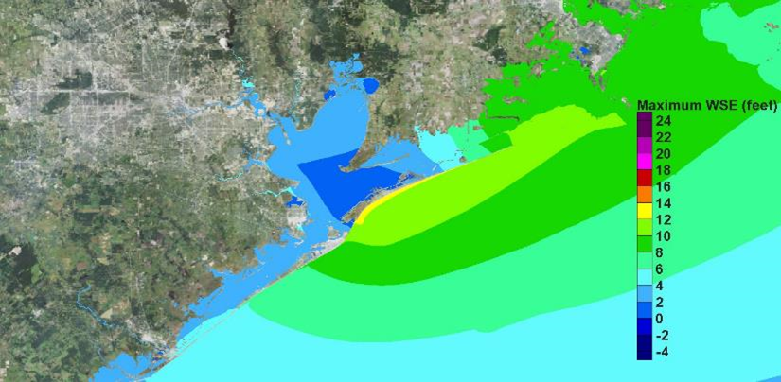
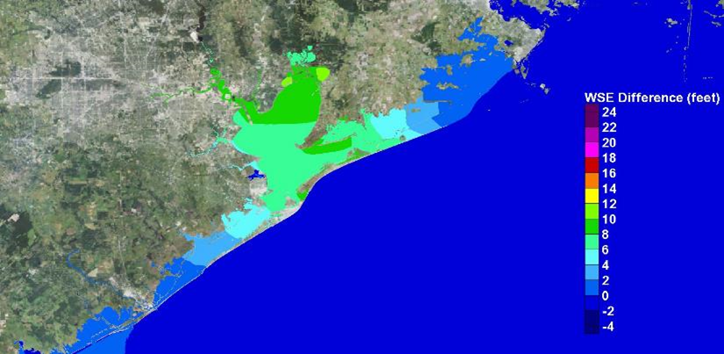
Surge Suppression for the 960-mb Direct Hit Storm
Existing
With-Dike
For this moderate hurricane, for existing conditions, surge in bay is 8 to 12 ft
With dike in place surges reduced to less than 4 ft; 6 to 9 ft of surge suppression
Difference

Slide 31
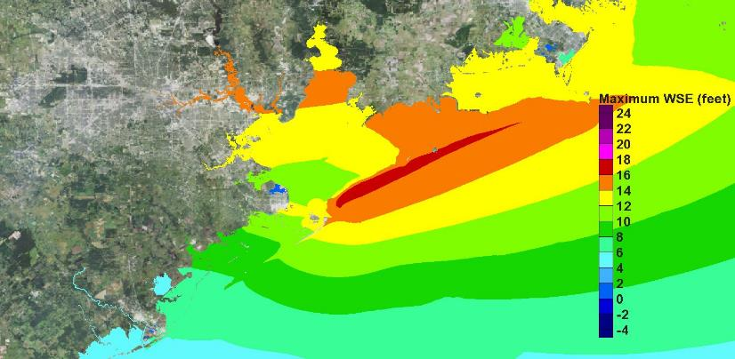
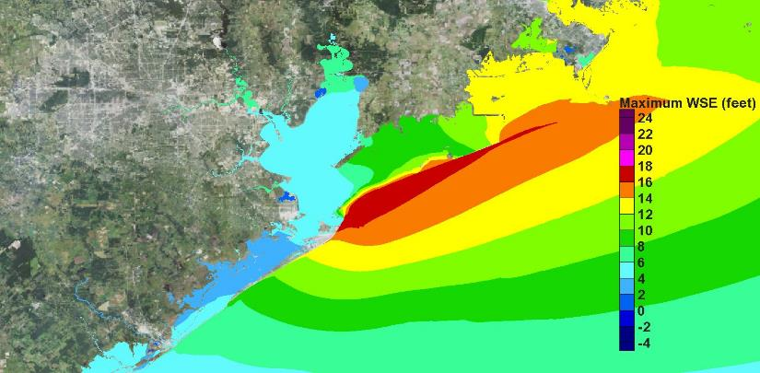
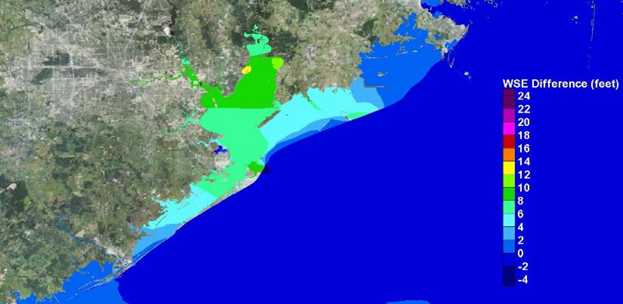
Surge Suppression for the 930-mb Direct Hit Storm
Existing
With-Dike
Existing condition surges comparable to Ike
With dike in place, surges in bay reduced to 3-7 ft; surge suppression of 7-10 ft
Difference

Slide 32
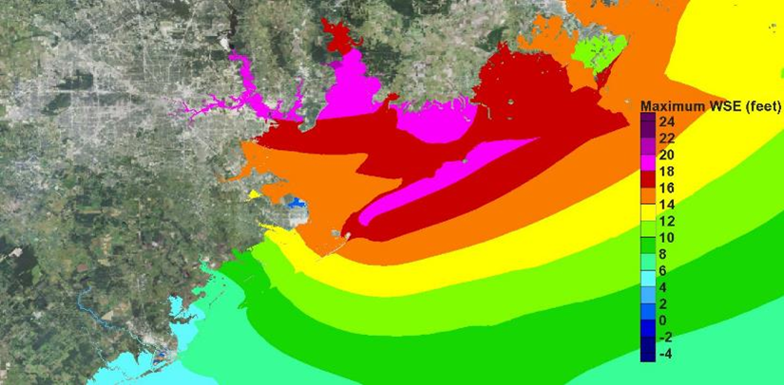
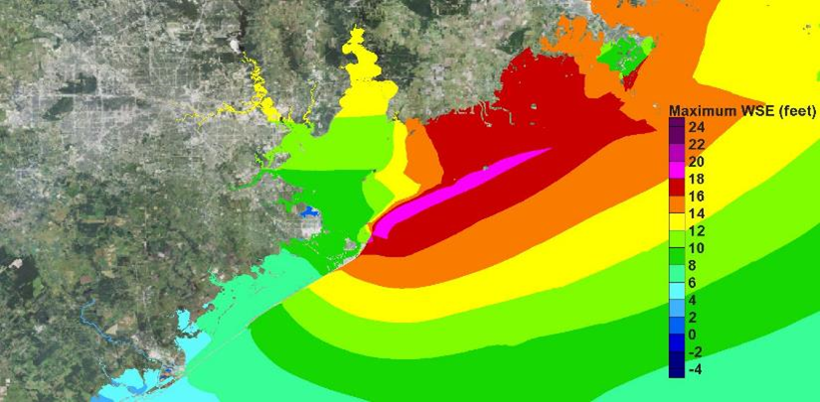
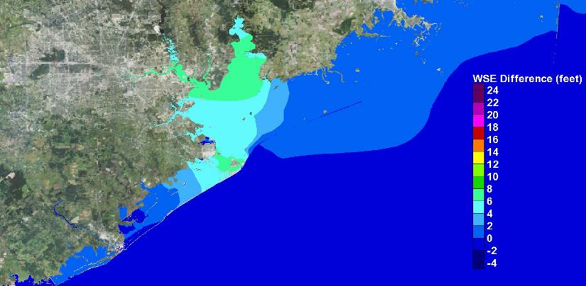
Surge Suppression for the 900-mb Direct Hit Storm
Existing
With-Dike
For this very extreme storm, in the bay, surges exceed Hurricane Ike surges by 5 to 7 ft – Catastrophic damage
With dike in place, surges reduced by 5 to 7 ft; still would have damage
Difference

Slide 33
Relative Roles of the Coastal Barrier and
Risk Reduction Measures Within the Bay
Before Quantitative Analysis Can Be Completed, Need to Examine Various Barrier Options and Model More Storms, But from This Example -
Coastal Barrier Is Effective in Reducing Surge in the Bay for All Storms
But for Some Severe Storms the Residual Bay Surge, Although Reduced, Will Be Damaging
In Bay Measures May Further Reduce This Residual Surge
In Bay Measures If Effective Could Also Reduce the Height Requirement for the Barrier
Complex Trade Offs – Economic, Environmental, Social

Slide 34
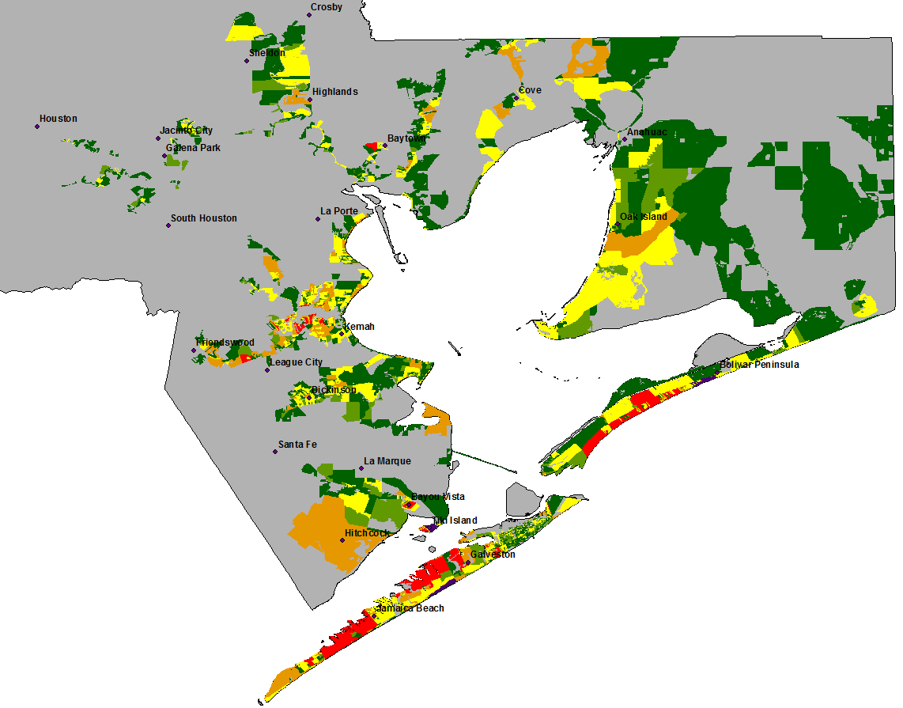
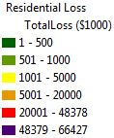
900mb Storm Existing Residential Loss by Census Block
Notes:
Note that we have one additional category (purple) where losses exceed 48 million.

Slide 35
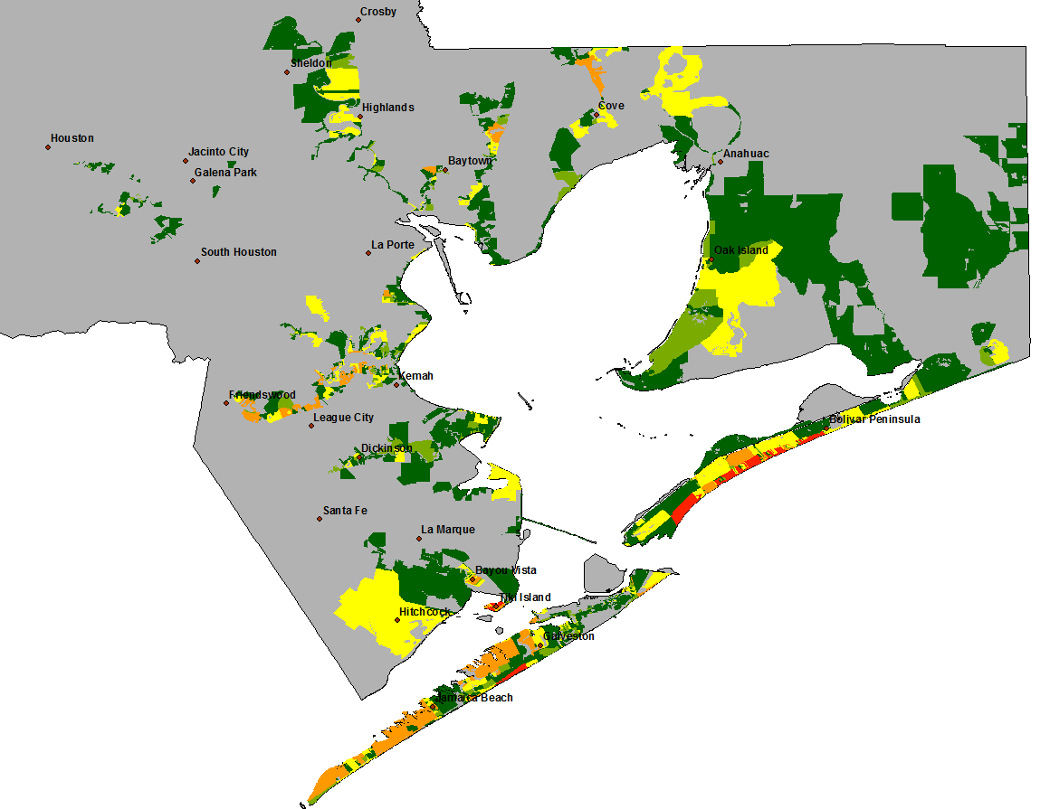
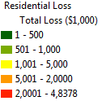
900mb Storm Protected Residential Loss by Census Block
Notes:
Note that maximum loss is about 48 million while we also have fewer census block that recorded residential losses.

Slide 36
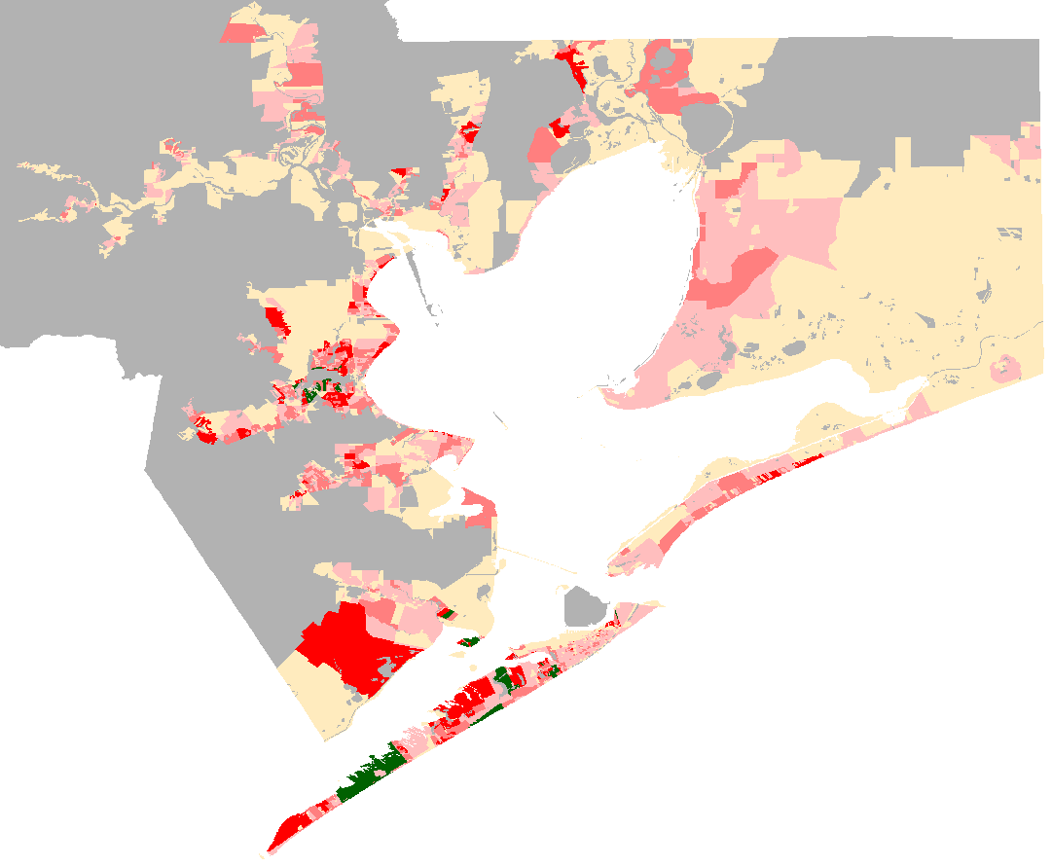
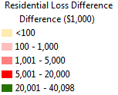
Residential Loss Avoided (930mbStorm)
Notes:
Note that maximum loss is about 48 million while we also have fewer census block that recorded residential losses.

Slide 37
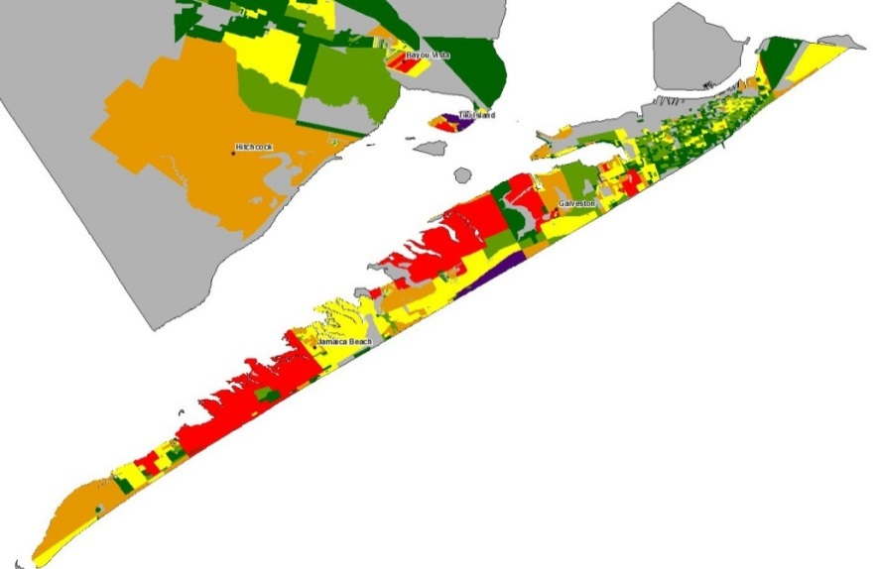
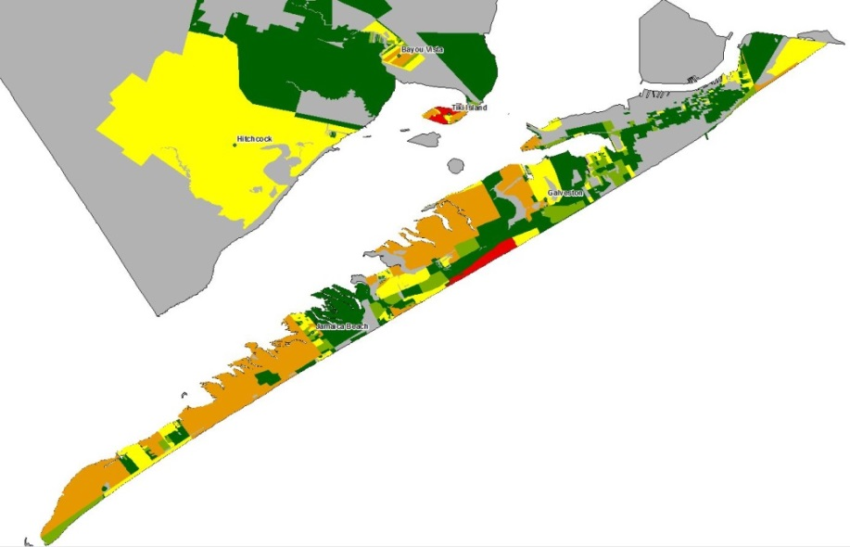
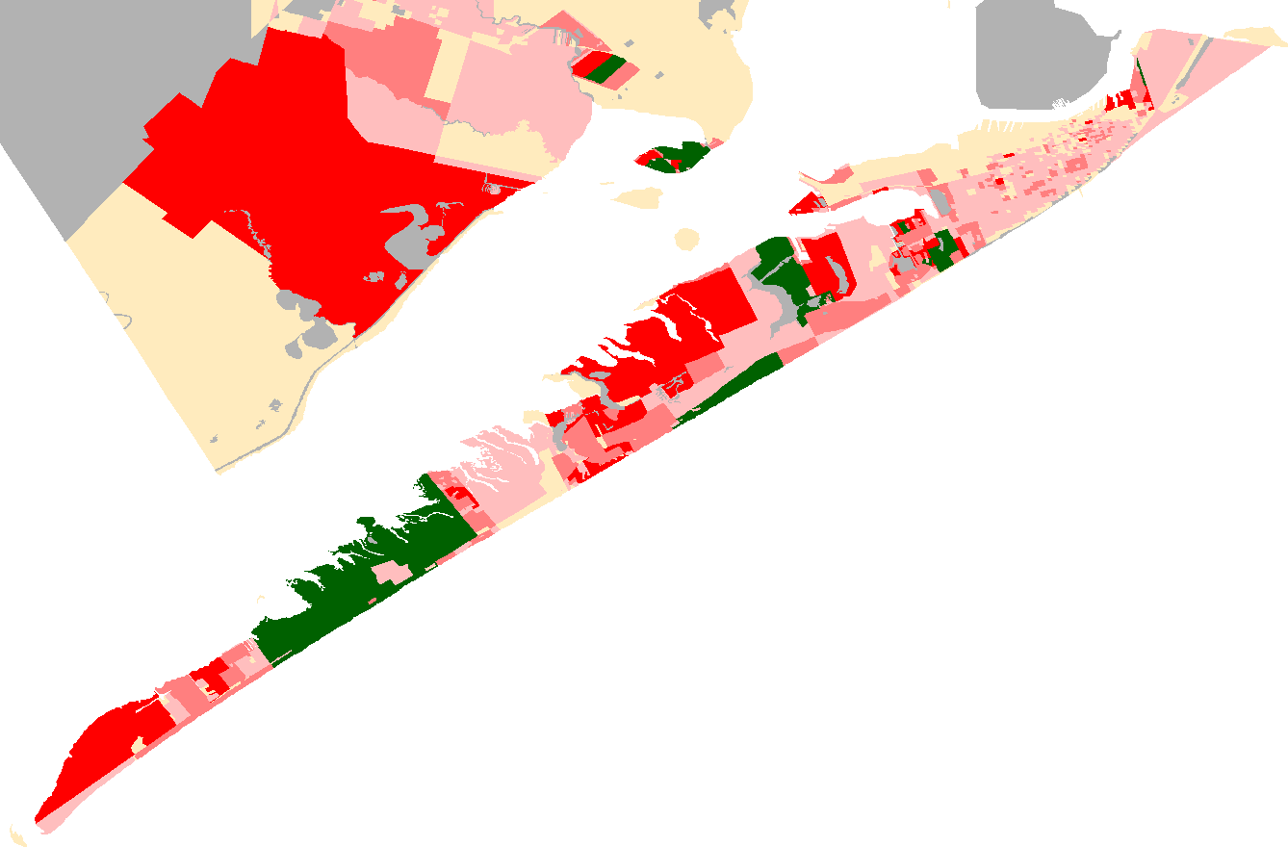
Existing
Protected
Difference

Slide 38
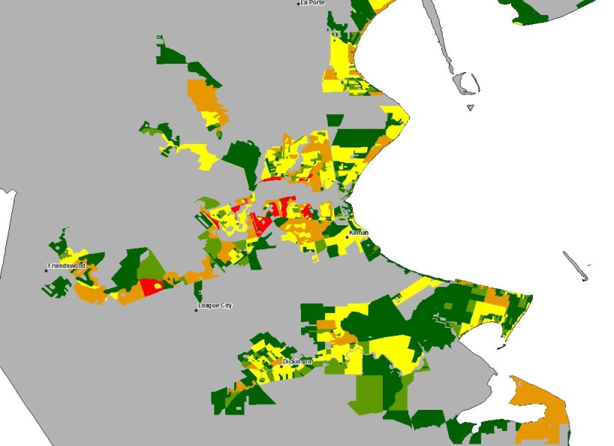
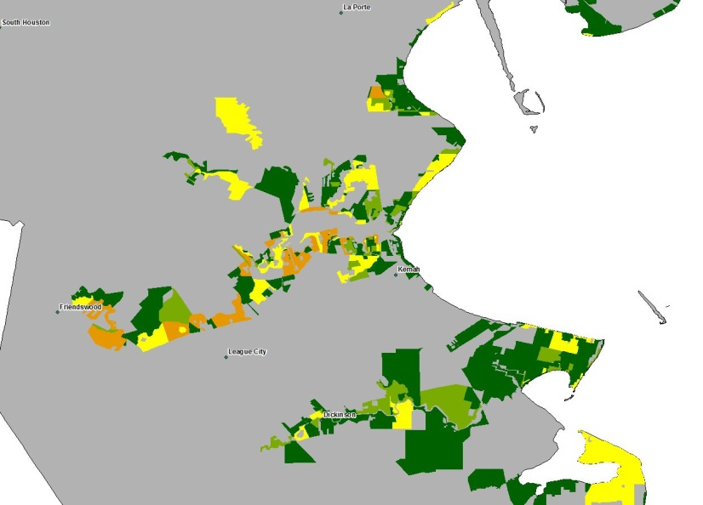
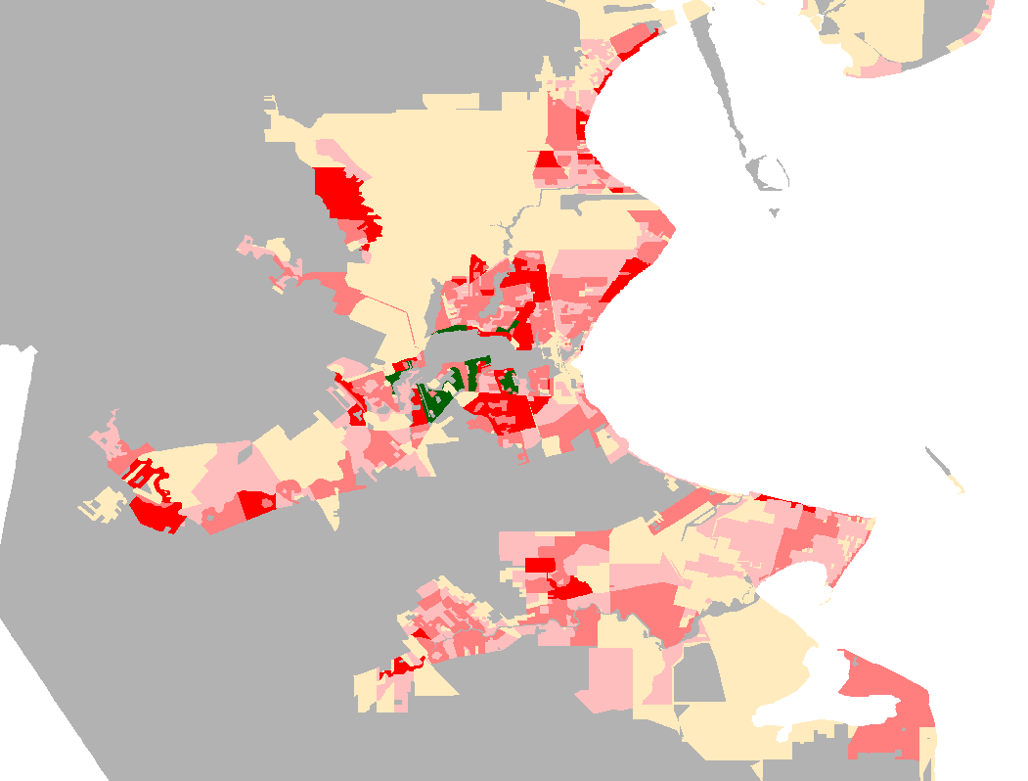
Existing
Protected
Difference

Slide 39
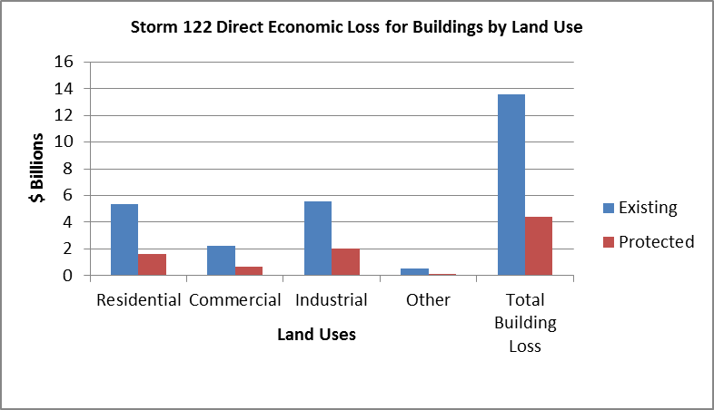
DRAFT Direct Economic Loss for Buildings by Land Use
900mb Storm
 | Existing | Protected
Residential | 5.32 | 1.60
Commercial | 2.21 | 0.63
Industrial | 5.54 | 2.00
Other | 0.50 | 0.15
Total Building Loss | 13.57 | 4.38
Notes:
Our analysis shows significant reduction in losses. For example, for the largest of the four storms (Storm A), Residential building and content loss without a coastal spine was approximately $5.32 billion. This economic impact was reduced to $1.60 billion with coastal protection in place. In fact, residential economic losses reduced by almost 70% while the combined building loss reduced by almost 68% with the placement of a 17-foot dike along Galveston Island

Slide 40
Determining Costs – Coastal Barrier
Water Barrier – Bolivar Roads Gate System Is By Far the Major Component of Cost
Soil Conditions for Water Barrier Foundations Biggest Unknown
Land Barrier – Fortified Dunes
Raising Coastal Highways Is an Option

Slide 41
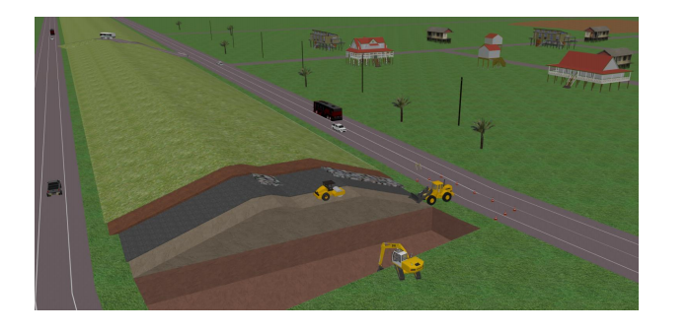
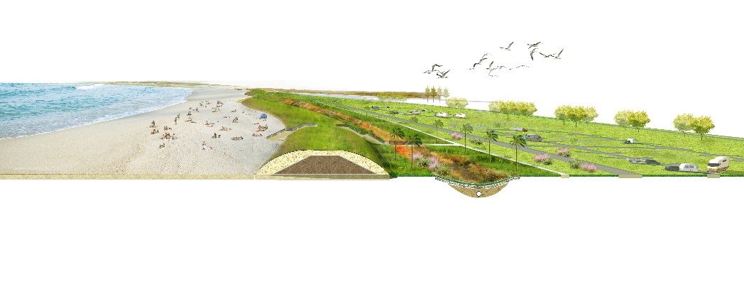
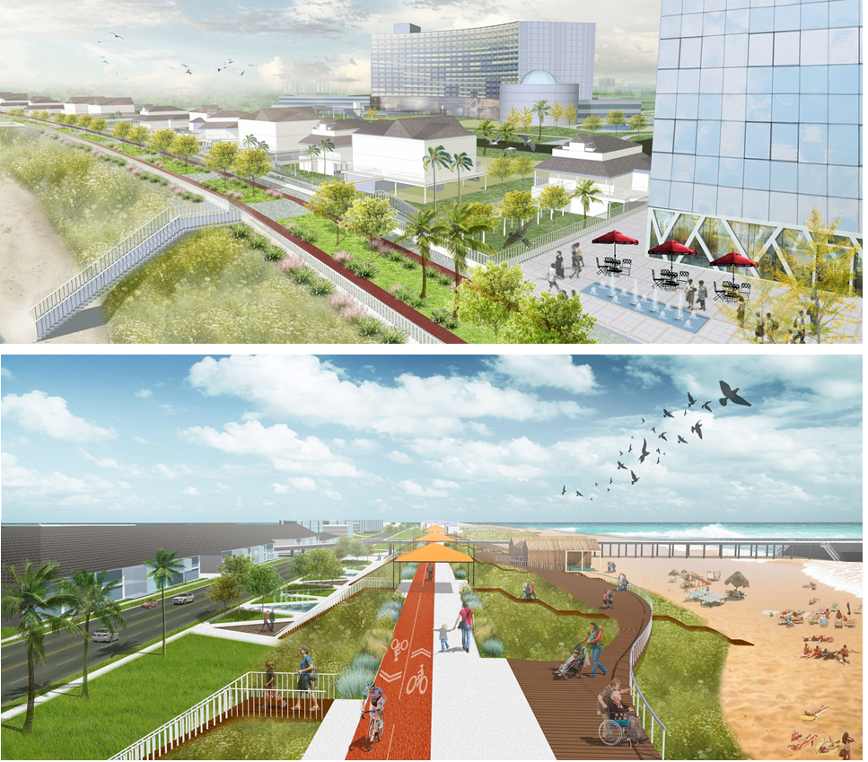
Land Barrier Solutions
Msc thesis N. West
Delft Student Team
Texas A&M (Bardenhagen and Newman)
TU Delft, prelim.

Slide 42
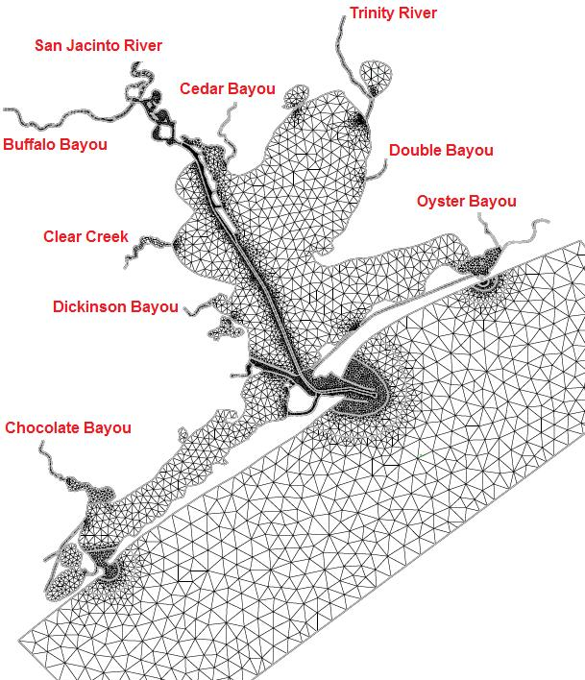
Bay Hydraulics - 2D – Depth Integrated
(M. Ruijs, 2011)
Impact of barrier
  Tidal Amplitude
  Current (shipping)
  Salinity (oyster, shrimp)
  Need 3-D Model

Slide 43
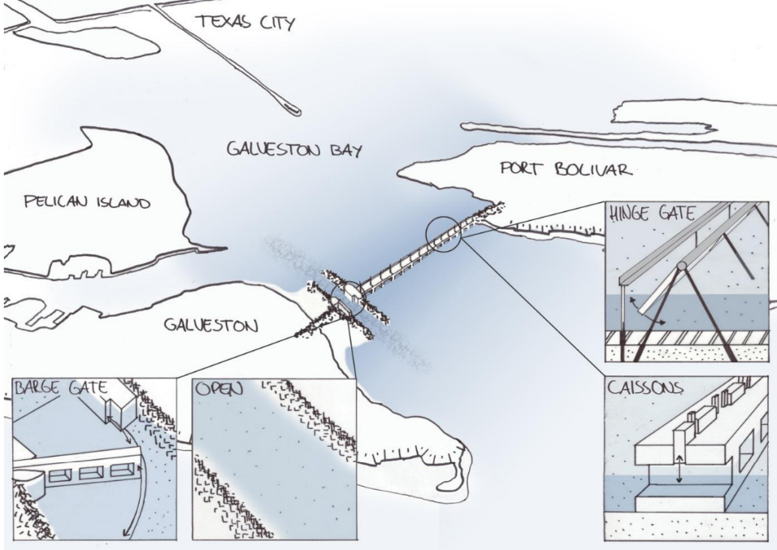
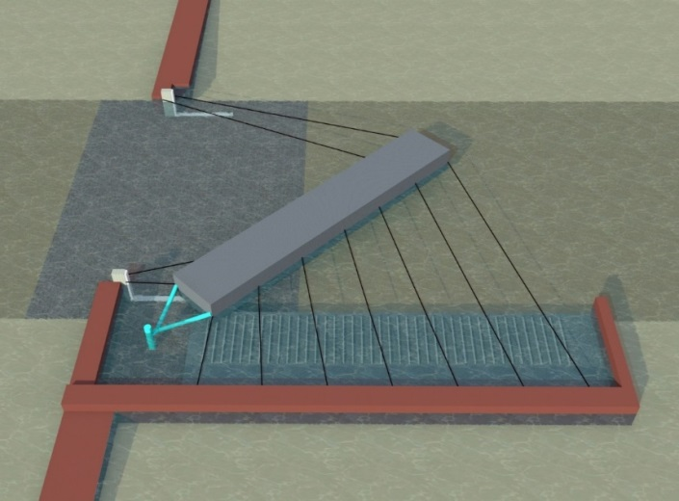
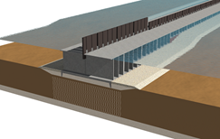
Water Barrier Solution
Navigation section
Environmental section

Slide 44
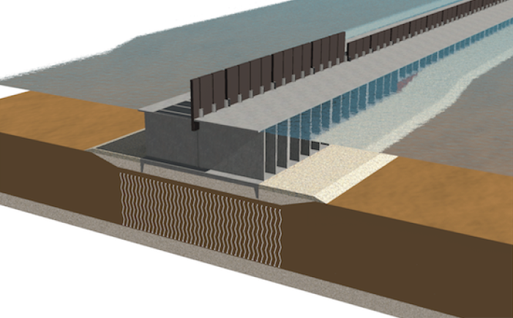
Bolivar Roads barrier: environmental section
(P. de Vries)
Main challenge: foundation

Slide 45
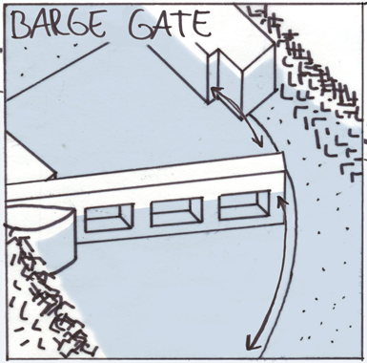
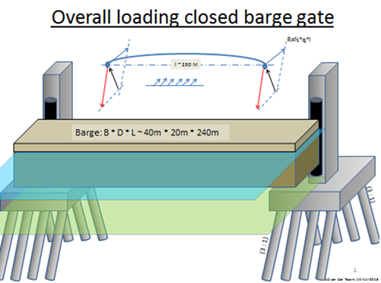
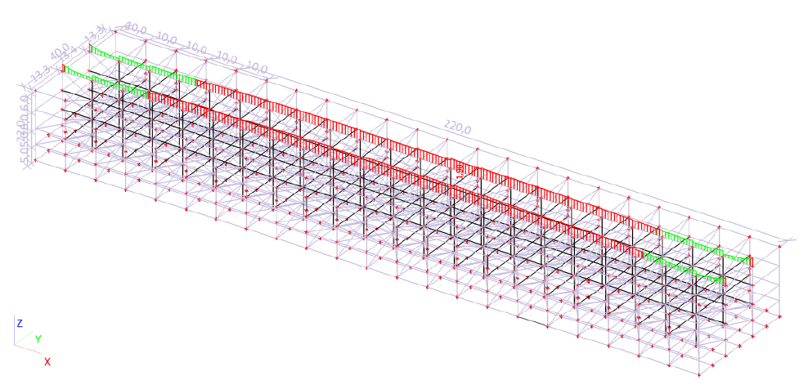
Bolivar Roads barrier: navigational section
c
Main challenges:
Hinge, dynamics, control
Structural analysis

Slide 46
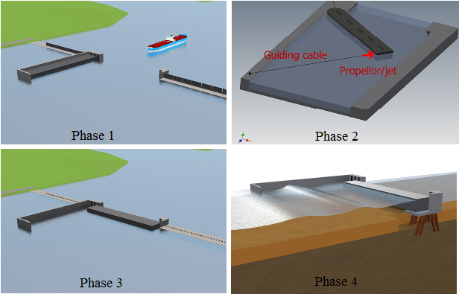
Operation barrier: closure

Slide 47



Barrier dynamic stability
(J. Smulders)
  Roll angle governing during swing operation
  Rubber supports required to ensure barge is not damaged at landing
  Additional measures required in case of negative head

Slide 48
From Flood Risk Reduction Meeting (Dec. 15th-16th, 2014)
Research Action Items
Flood
Risk
Reduction
Surge/Flood Modeling
Barrier Design
Make available FEMA 10/100/500yr without protection max water surface elevation files.
Extend barrier up towards Sabine to prevent flow around.
Select proxy storm for each recurrence interval.
Run (3) with protection.
Exchange IKE max water surface elevation.
Additional named storms:
Ike, re-track Ike, re-track Carla, 1900 storms (short term).
● SSPEED has previous named storms (Katrina, Rita, Isaac, Ike done @ P7).
Carla and 1900 will be done with JSU winds (P7).
● 1900 hurricane wind and pressure
Probabilistic Storms: Assess which storms are important to run-ruling out, which storms can eliminate because of insignificant damage (900-975).
Assess alternatives based on same FEMA storms.
Examine different barrier heights.
Save wave spectrum at San Luis and Bolivar.
Water Barrier:
● Delft-Cost Estimate by spring
a. Bigger opening for navigation
b. Scour protection issues
c. Soil issue, need cores (LT)
d. Alternative environmental Barrier
e. Flow and fish larvae issues
f. Overflow, leakage during storm
● Nice visualization needed
Land Barrier
● Estimates of alternative costs based no different heights.
● Examine alternative construction designs/costs.
● Better understand sand availability and costs.
● Decide on placement of barrier (beachfront vs. road).
● Visualization
Bay Interior
● Visualization
● Land use issues
● Buy out targets
● (MT) “Charrette” working with nature to design barriers within the bay.
● SSPEED leads interior efforts, and decides when we all get involved.
Economics
Finish populating HAZUS model-residential: Run for IKE
Finish Industrial dataset and integrate into model.
Develop a detailed written document for surge model-economic interface.
Run storms without protection for baseline economics.
Damage assessment for storms with complete data (total damage) for protection scheme.
IMPLAN Analysis
Land use change analysis?
(M/LT) loss of life analysis
Economic benefit of constructing the barrier or other alternatives: development, tourism, ecosystem services (MT).
Lower insurance payments and claims.
(M/LT) costs for different elevations and connect to return periods.
Maintenance, operational cost issues.
TAMU/TAMUG
Dutch
SSPEED Center
Jackson State
U. of Houston

Slide 49
Summary
Coastal Barrier (Ike Dike) Greatly Reduces Surge Damage for All Storms
A 17ft high barrier would “handle” most storms
Well on Our Way to a Preliminary Cost/Benefit Analysis and a Very First Cut at an Actionable Plan
Strong Research Team and Plans in Place to Continuously Improve the Actionable Plan
Will Need To Raise Additional Resources to Continue Our Work

Slide 50
What You Can Do!
Take Pride that Your City Started All This
Get Angry and Stay Angry
Demand Galveston Bay Be Treated Like Other Hard-Hit Areas
Recognize that Our Region Has Already Overwhelming Supported a Surge Suppression Approach that Features the Coastal Barrier
Realize that Special Congressional Legislation Will Be Necessary
Push for an Actionable Plan to Help Such Legislation
Acknowledge that Now Only Academic-Led Researchers with Local Funding Are Working to Produce a Plan
Urge Additional Funding Be Focused on Progress Toward Achieving Federal Legislation
Work with State and Federal Officials and Legislators to support Surge Suppression for the Galveston Bay Region As Soon As Possible

Slide 51








